Slide 1
Analysis of the job market for data analysts in the USA
Ironhack, Berlin, 16 April 2024
Olsi Mosha
Sergii Lebid

Slide 2
The main goal of the research was to determine the position of data analysts in the income hierarchy across different states.

Slide 3
The hypothesis:
In different states, data analysts have varying income levels
There is a significant difference in the number of vacancies between the states
The income level of data analysts is above the state average

Slide 4
Project Overview
The main goal of the research was to determine the position of data analysts in the income hierarchy across different states.
The hypothesis:
In different states, data analysts have varying income levels
There is a significant difference in the number of vacancies between the states
The income level of data analysts is above the state average

Slide 5
Project Overview
The sources:
- linkedin-jobs-usa.csv file (2022)
- https://fred.stlouisfed.org - Per Capita Personal Income by State, Annual (2022)
- https://worldpopulationreview.com/states - US States - Ranked by Population (2022)
The analysis focuses on:
- the job market situation for data analysts across individual states
- comparing the average offered salary to the average income level by state

Slide 6
Project Overview
The structure and process of your data cleaning and analysis:
The linkedin-jobs-usa.csv database was cleaned, sorted, and analyzed based on the following components: title, company, description, onsite_remote, salary, location, criteria, posted_date, and link
Using web scraping from the resource https://fred.stlouisfed.org, data on average income per capita by state was obtained
Using web scraping from the resource https://worldpopulationreview.com/states, data on population by state was obtained

Slide 7
Data Wrangling and Cleaning
1
The data used for the analysis from linkedin-jobs-usa.csv included, the following components: title, description, salary, location
2
The “salary” component was cleaned and filled and dropped, the “location” component was cleaned, the “title” component was grouped
3
Web screening was an typical assignment without any issue

Slide 8
Teamwork & Project Management
New ideas emerged during project preparation
Not all ideas could be implemented
Some of the ideas ultimately proved to be ineffective

Slide 9
Major Obstacle
Absence of time-correlated information in line with the database led to the initial idea being altered during work and attempts to find the required information
Not all websites are easily scraped, sometimes requiring alternative sources of information that may not align with the initial queries
The quality of initial information in the database significantly impacts the success of the research

Slide 10
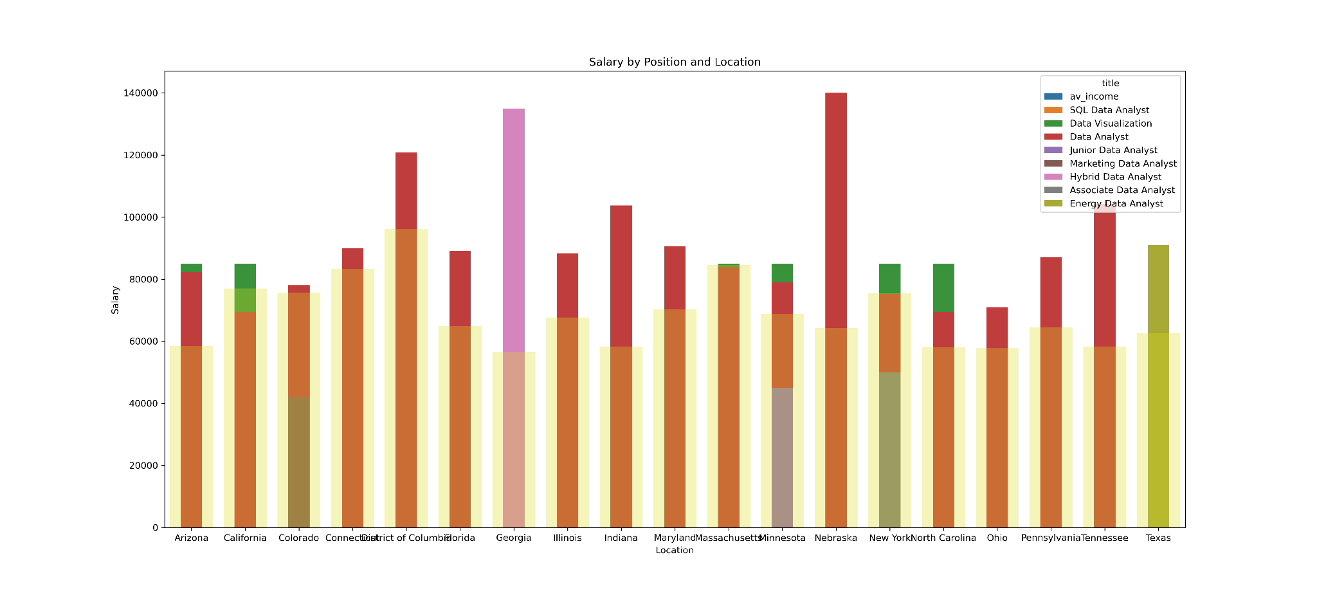
Сonclusion and Insights
Hypothesis 1: In different states, data analysts have varying income levels

Slide 11
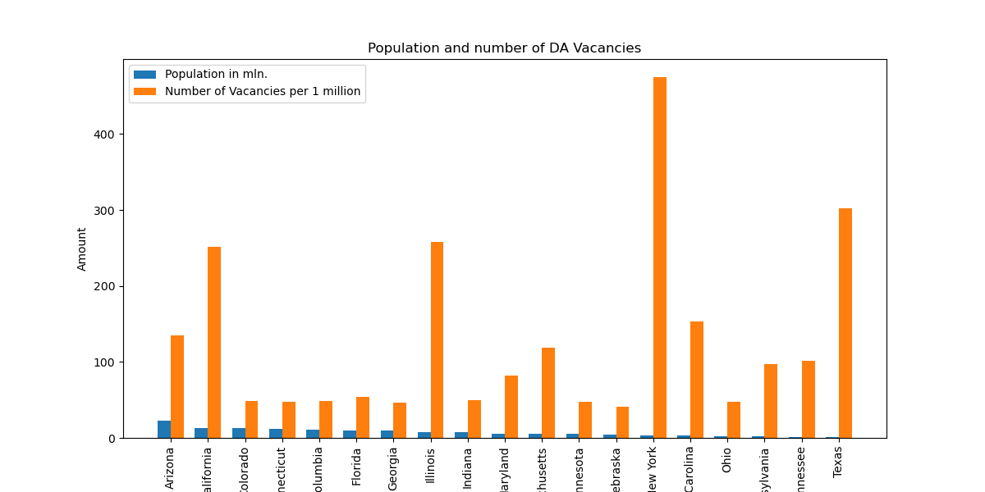
Сonclusion and Insights
Hypothesis 2: There is a significant difference in the number of vacancies between the states

Slide 12
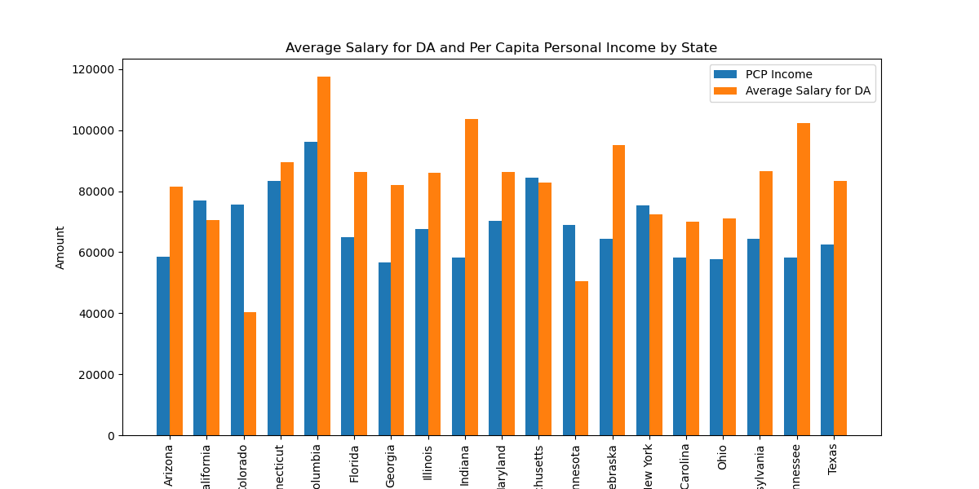
Сonclusion and Insights
Hypothesis 3: The income level of data analysts is above the state average

Slide 13
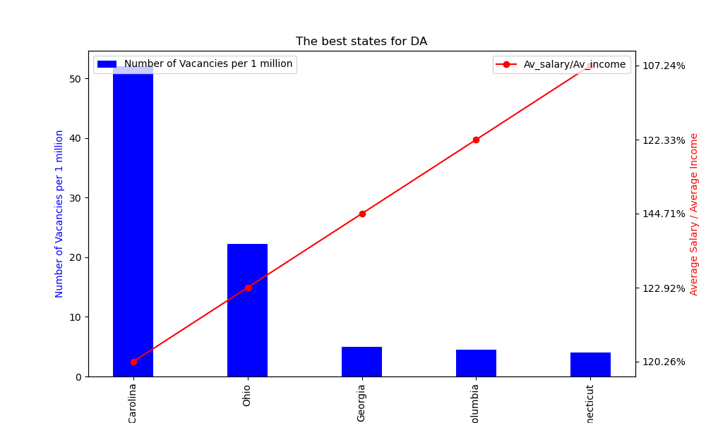
Fascinating information

Slide 14

Thank you!
Ironhack, Berlin, 16 April 2024
Olsi Mosha
Sergii Lebid

